Slide 1

De-escalation In Action
Solving Challenges with Confidence

Slide 2

Learning Goals
To enhance communication skills and reduce conflict.
De-escalation is about understanding, adapting, and responding calmly.
Understanding the basics of de-escalation
Learning practical steps to handle unexpected challenges calmly
Non-threatening phrases
Progressive Discipline Flow Chart

Slide 3
Understanding the Difference
Escalation
De-escalation
Amplifying a situation by responding with heightened emotions, threats, or defensiveness.
Calming a situation by reducing tension, listening, and maintaining control.
Aims to restore collaboration, trust, and mutual respect.
Often leads to conflict, misunderstandings, or unproductive outcomes.

Slide 4
"10% of conflict is due to a difference in opinion, and
90% is due to delivery and tone"

Slide 5
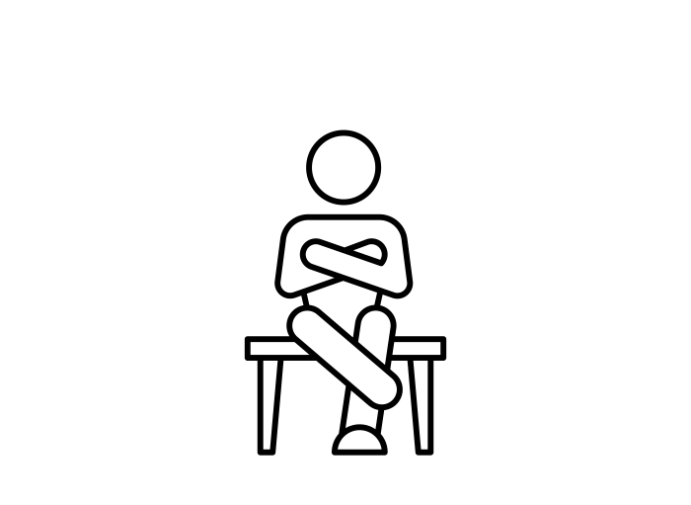


Understanding the Difference
Escalation
De-escalation
Tone
Loud, Aggressive
Calm, Steady
Closed Off,
Threatening
Body Language
Open, Relaxed
Defensive,
Accusatory
Understanding,
Empathetic
Response Style

Slide 6
Escalation or De-escalation?
Speaking quickly, interrupting, and using a sarcastic tone.
Rolling eyes, sighing loudly, and crossing arms.
Escalation
Escalation
Nodding while listening, maintaining eye contact, and pausing before responding.
Speaking in a calm tone while keeping an open posture and relaxed arms.
De-Escalation
De-Escalation

Slide 7


Effective communication is essential in the workplace, especially when resolving conflicts.
“I”
“You”
“I” statements focus on expressing personal feelings and perspectives without assigning blame. This approach reduces defensiveness and keeps the conversation constructive.
“You” statements often place blame or assign fault, which can make the other person feel defensive, criticized, or attacked causing the conversation to escalate.

Slide 8

Effective De-escalation
“I” Statements
“You” Statements
Acknowledging
Emotions and Concerns
﻿﻿﻿"I hear what you're saying, and I appreciate you bringing this to my attention."
“You always complain about things instead of trying to fix them yourself.”
﻿﻿﻿﻿"I value your input, and I want to ensure we approach this constructively."
Calming the Situation
“Your input is not helpful, and this is why nothing ever gets resolved.”
"I think we might have a slight misunderstanding. Can we revisit this together to get on the same page?"
“You clearly don’t understand anything, and there’s no point in discussing this further.”
Clarifying and Redirecting
Focusing on
Collaboration and Solutions
"Let's focus on what we can do to improve things from here."
“You never take responsibility; that’s why things never get done.”

Slide 9

“You can't read the recipe?
These portions
are all wrong.”
Flip the Script
“You always take too long on the
serving lines. Your too slow!”
Flip these “YOU” statements to “I” statements.
“You never check the temperature like your suppose to. Its not that hard!”
“I'm concerned that the temperature logs aren’t being completed regularly, and that puts us at risk for safety. Let's go over how to complete these forms accurately.”
“You never check the temperature like your suppose to. Its not that hard!”
“You always take too long on the
serving lines. Your too slow!”

Slide 10



Slide 11
Flip the Script
Flip these “YOU” statements to “I” statements.
“You can't read the recipe?
These portions
are all wrong.”
“I’m open to hearing about your concerns, so we can focus on possible ways we can
improve things.”
“You’re always complaining about everything.”
“You’re always outside talking to the after-school staff instead of doing
your job.”
“You always take way too long on the
serving lines. Your too slow!”

Slide 12
“You’re always complaining about everything.”
Flip the Script
Flip these “YOU” statements to “I” statements.
“I want to make sure the recipe steps and portions sizes are clear so we’re consistent across the board. Let's take a moment to review it together.”
“You can't read the recipe?
These portions
are all wrong.”
“You’re always outside talking to the after-school staff instead of doing
your job.”
“You always take way too long on the
serving lines. Your too slow!”

Slide 13
“You’re always complaining about everything.”
Flip the Script
Flip these “YOU” statements to “I” statements.
“You can't read the recipe?
These portions
are all wrong.”
“I noticed you were chatting with the after-school staff during prep.
I want to make sure we’re staying focused during work hours so everything's ready for service.”
“You’re always outside talking to the after-school staff instead of doing
your job.”
“You always take way too long on the
serving lines. Your too slow!”

Slide 14
“You’re always complaining about everything.”
Flip the Script
Flip these “YOU” statements to “I” statements.
“You can't read the recipe?
These portions
are all wrong.”
“I’ve noticed the pace on the serving line has been a bit slower, and it's impacting how quickly we serve the students. Let's discuss ways that can make the line run more smoothly for service.”
“You always take way too long on the
serving lines. You’re too slow!”
“You’re always outside talking to the after-school staff instead of doing
your job.”

Slide 15
Handling Unexpected
Challenges
Pause – Take a moment and evaluate the situation.
Actively Listen – Hear their concerns without interruption.
Empathize – Show you understand their perspective.
Resolution – Keep the conversation solution focused.

Slide 16


Navigating through
Progressive Discipline
The Flow Chart is a tool that was created to assist the FSM and AFSS in recommending the disciplinary action and documentation to be used for any policy and/or procedure infraction incurred by the employee.
The disciplinary actions listed in the flow chart are suggested and not absolute.
If in doubt contact your AFSS or HR Representative.
Food Services Website > Human Resources > Disciple > “Progressive Disciple Flow Chart”

Slide 17
Productive De-escalation
It is said that companies that incorporate conflict resolution training, including de-escalation techniques, reported that 90% of disputes were resolved without escalating to formal resolution process.

Slide 18
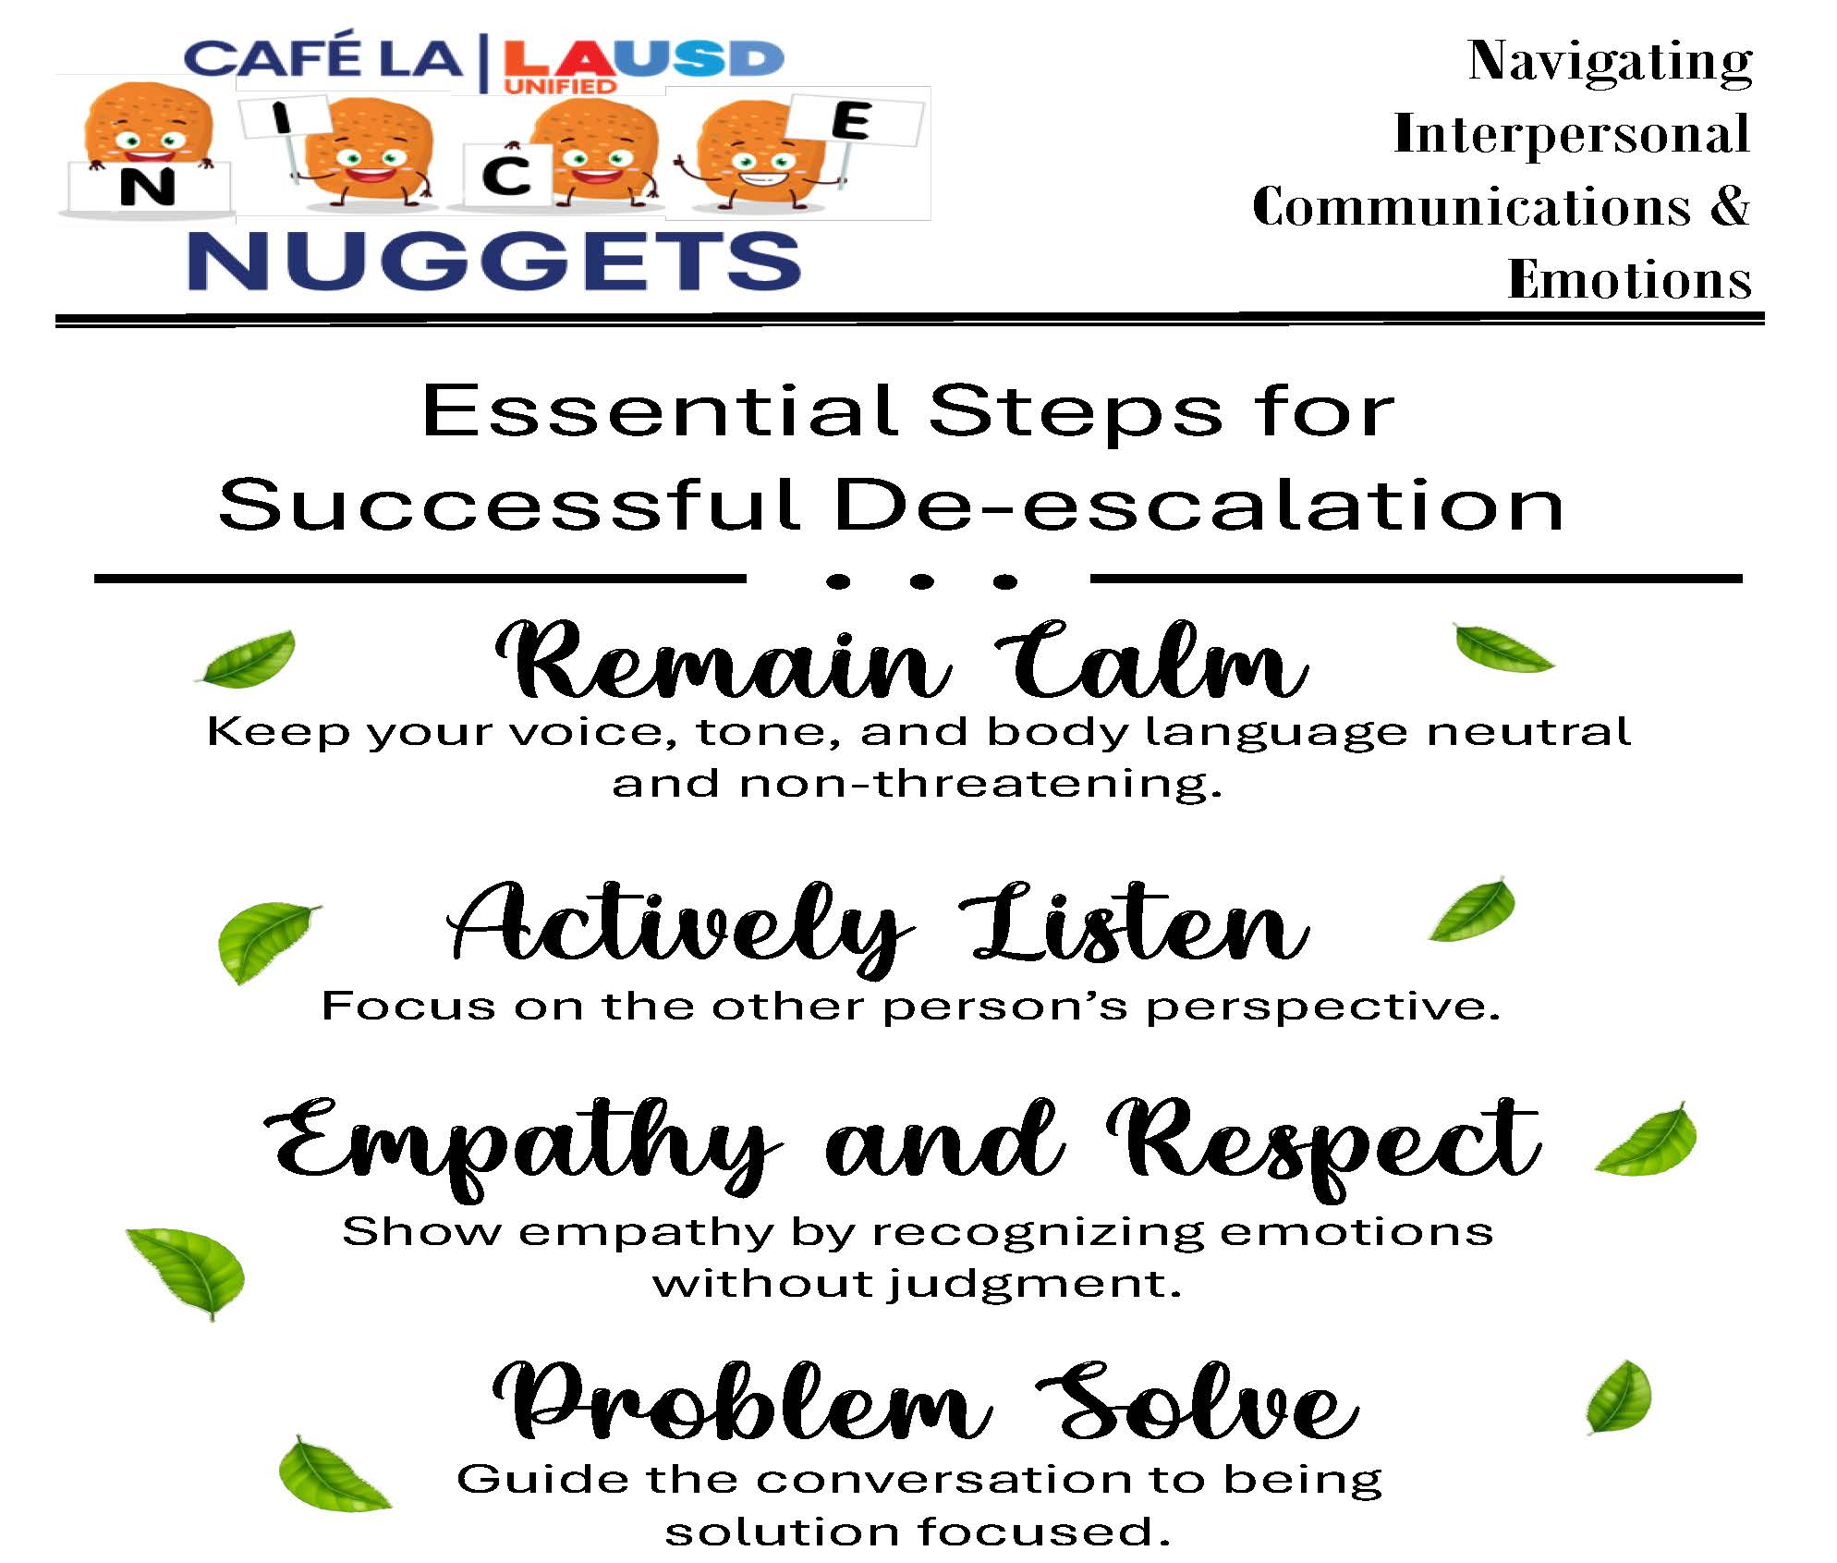

Share and read aloud the
“NICE NUGGETS”
poster with your staff.
Post it in a visible area for your staff to review as they please.

Slide 19
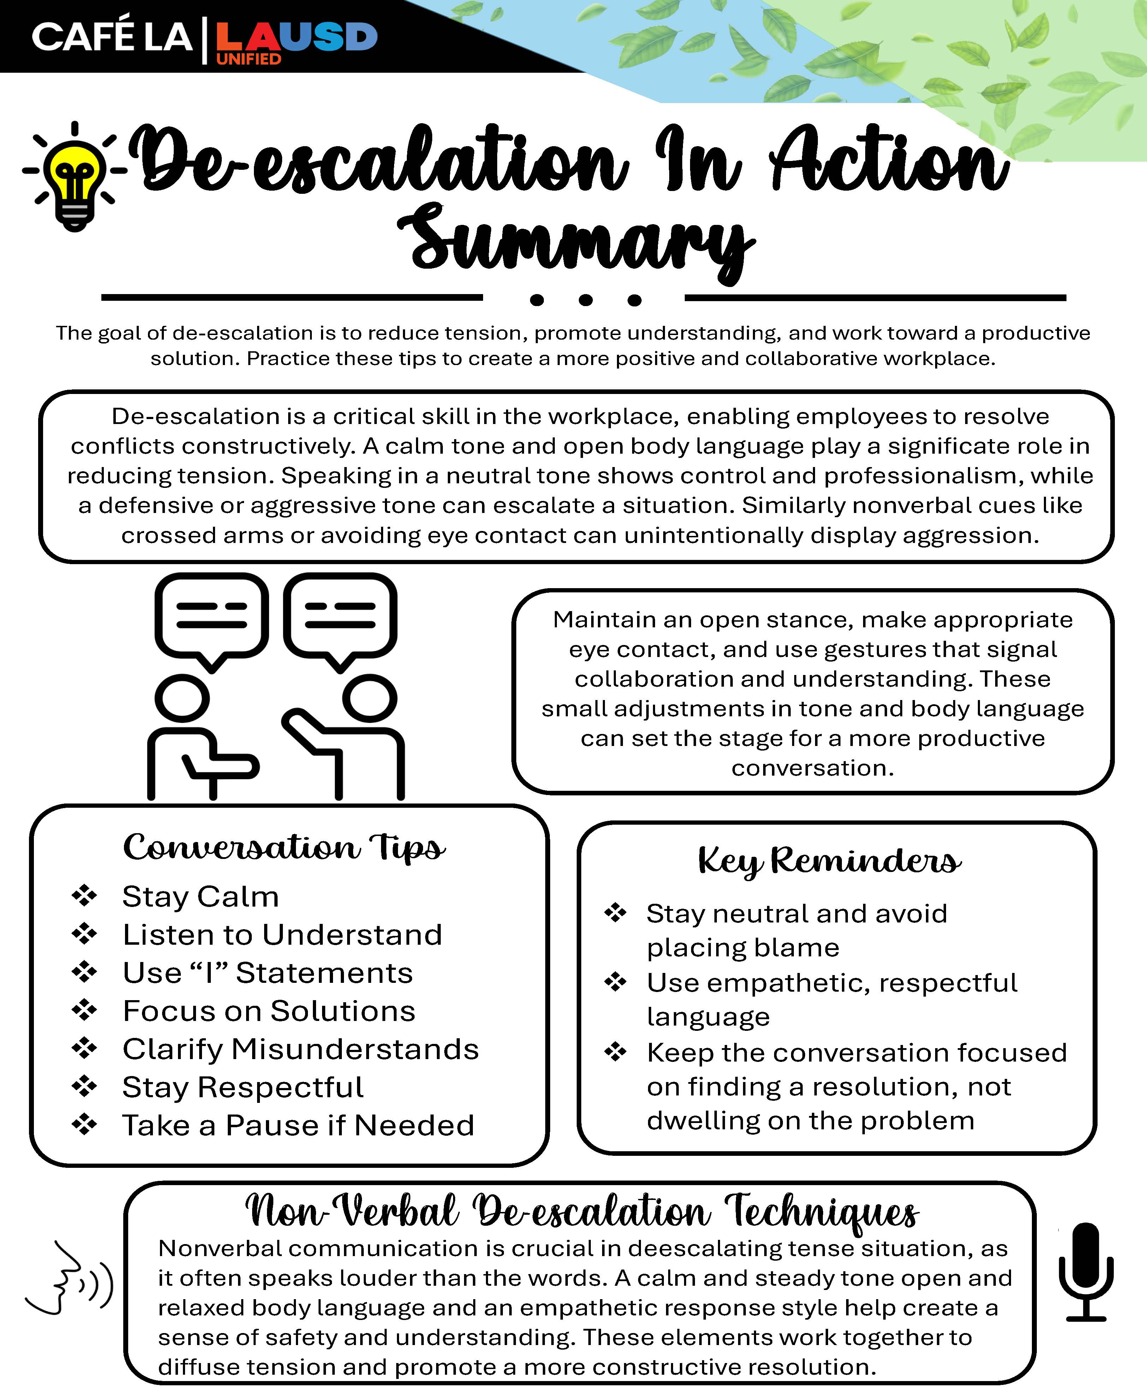

Please enjoy the summary handout and retain throughout the
NICE Workshop Program
in your 3-ring binder!

